Slide 1


Compiler Construction
Lecture 04

Slide 2
Chapter 03
Lexical Analyzer

Slide 3
Objectives
You will learn about;
Unit 4.1 :
  Lexical Analyzer
Unit 4.2 :
  Role of Lexical Analyzer
Unit 4.3 :
  Regular Expressions
Unit 4.4 :
  Recognition of Tokens

Slide 4
UNIT 4.1
Home
  Lexical Analyzer

Slide 5
Lexical Analyzer in Perspective
token
source program
lexical analyzer
parser
get next token
symbol table
Important Issue:
What are Responsibilities of each Box ?
Focus on Lexical Analyzer and Parser

Slide 6
Lexical Analyzer
Definition:
- Lexical analysis is the first phase of a compiler. It takes the modified source code from language preprocessors that are written in the form of sentences.
- Lexical analysis breaks these syntaxes into a series of tokens, by removing any white spaces or comments in the source code.
Source Code
Lexical Analyzer
Tokens
Syntax Analyzer
Lexers
Req. for Tokens

Slide 7
UNIT 4.2
Home
  Role of Lexical Analyzer

Slide 8
Lexical Analysis
Basic Concepts & Regular Expressions
  What does a Lexical Analyzer do?
  How does it Work?
  Formalizing Token Definition & Recognition
Reviewing Finite Automata Concepts
  Non-Deterministic and Deterministic FA
  Conversion Process
    Regular Expressions to NFA
    NFA to DFA
Relating NFAs/DFAs /Conversion to Lexical Analysis

Slide 9
Lexical Analyzer
Scanner are divided into two phases:
Scanning consists of the simple processes that do not require tokenization of the input, such as deletion of comments and compaction of consecutive whitespace and characters into one.
Lexical analysis proper is the more complex portion, where the scanner produces the sequences of tokens as output.

Slide 10
What Factors Have Influenced the Functional Division of Labor ?
Separation of Lexical Analysis From Parsing Presents a Simpler Conceptual Model
  A parser embodying the conventions for comments and white space is significantly more complex that one that can assume comments and white space have already been removed by lexical analyzer.
  From a Software Engineering Perspective Division Emphasizes
    High Cohesion and Low Coupling
    Implies Well Specified ⇒ Parallel Implementation
Separation Increases Compiler Efficiency
  Specialized buffering techniques for reading input characters and processing tokens…
Separation Promotes Portability
  Input alphabet peculiarities and other device-specific anomalies can be restricted to the lexical analyzer.
  This is critical today, when platforms (OSs and Hardware) are numerous and varied!
  Emergence of Platform Independence - Java

Slide 11
Basic Terminology
What are Major Terms for Lexical Analysis?
  TOKEN
    A pair consisting of a token name and an optional attribute value.
    A particular keyword, or a sequence of input characters denoting identifier.
    Examples Include Identifier, Integer, Float, Assign, LParen, RParen, etc.
  PATTERN
    A description of a form that the lexemes of a token may take.
    For keywords, the pattern is just a sequence of characters that form keywords.
    Example: The rules which characterize the set of strings for a token – integers [0-9]+
  LEXEME
    Actual sequence of characters that matches pattern and is classified by a token. Examples include:
    Identifiers: x, count, name, etc…
    Integers: 345, 20 -12, etc.

Slide 12
Basic Terminology
Token
Sample Lexemes
Informal Description of Pattern
const
if
relation
id
num
literal
const
if
<, <=, =, < >, >, >=
pi, count, D2
3.1416, 0, 6.02E23
“core dumped”
const
characters of i, f
< or <= or = or < > or >= or >
letter followed by letters and digits
any numeric constant
any characters between “ and “ except “
Actual values are critical. Info is :
  1. Stored in symbol table
  2. Returned to parser
Classifies Pattern

Slide 13
Handling Lexical Errors
Its hard for lexical analyzer without the aid of other components, that there is a source-code error.
  If the statement fi is encountered for the first time in a C program it can not tell whether fi is misspelling of if statement or a undeclared literal.
  Probably the parser in this case will be able to handle this.
Error Handling is very localized, with Respect to Input Source
For example: whil ( x = 0 ) do
generates no lexical errors in language

Slide 14
Handling Lexical Errors
Error Handling is very localized, with Respect to Input Source
For example: whil ( x := 0 ) do
generates no lexical errors in PASCAL
In what Situations do Errors Occur?
  Prefix of remaining input doesn’t match any defined token
Possible error recovery actions:
  Deleting or Inserting Input Characters
  Replacing or Transposing Characters
Or, skip over to next separator to “ignore” problem

Slide 15
I/O - Key For Successful Lexical Analysis
Character-at-a-time I/O
Block / Buffered I/O
Block/Buffered I/O
  Utilize Block of memory
  Stage data from source to buffer block at a time
  Maintain two blocks - Why (Recall OS)?
    Asynchronous I/O - for 1 block
    While Lexical Analysis on 2nd block
Tradeoffs ?
Block 1
Block 2
When done, issue I/O
ptr...
Still Process token in 2nd block

Slide 16
Algorithm: Buffered I/O with Sentinels
Lexical Analyzer in Perspective
Current token
E
=
M
*
eof
C
*
*
2
eof
eof
lexeme beginning
forward (scans ahead to find pattern match)
forward : = forward + 1 ;
if forward ↑ = eof then begin
if forward at end of first half then begin
reload second half ;
forward : = forward + 1
end
else if forward at end of second half then begin
reload first half ;
move forward to beginning of first half
end
else / * eof within buffer signifying end of input * /
terminate lexical analysis
end
Block I/O
Algorithm performs
I/O’s. We can still
have get & un getchar
Now these work on
real memory buffers !
Block I/O
2nd eof ⇒ no more input !

Slide 17
Attributes for Tokens
When more than one lexeme can match a pattern, a lexical analyzer must provide the compiler additional information about that lexeme matched.
Information about identifiers, its lexeme, type and location at which it was first found is kept in symbol table.
The appropriate attribute value for an identifier is a pointer to the symbol table entry for that identifier.

Slide 18
Attributes for Tokens
Tokens influence parsing decision;
The attributes influence the translation of tokens.
Example: E = M * C ** 2
<id, pointer to symbol-table entry for E>
<assign_op, >
<id, pointer to symbol-table entry for M>
<mult_op, >
<id, pointer to symbol-table entry for C>
<exp_op, >
<num, integer value 2>

Slide 19
Lexical Analyzer
We begin the study of lexical analyzer generators by introducing regular languages and expressions, a convenient notation for specifying lexeme patterns.
The stream of tokens is sent to the parser for syntax analysis.

Slide 20
UNIT 4.3
Home
  Regular Expressions

Slide 21
Regular Expressions
A regular expression is a notation to represent languages, i.e. a set of strings, where the set is either finite or contains strings that are generated using simple recursive rules.
The languages represented by regular expressions are called regular languages.
Example. The set of integer constants used in a typical programming language: an integer constant contains a sequence of one or more decimal digits, up to some system-dependent maximum length.
Example. variable name: starting with a letter, followed by zero or more letter of digit characters, or certain punctuation symbols (such as the underscore “_”, dash “-”), up to certain maximum length.

Slide 22
Regular Expressions
More precisely, let A be an alphabet (i.e., a finite, non-empty set of symbols). The collection of regular languages over A is defined by the following (recursive) rules:
Base step: The empty set ∅, {ε}, and {a} for every a∈ A are regular languages;
Recursive step: If X and Y are regular languages, then the sets X ∪ Y (union), X · Y (concatenation), and X* (Kleene star) are regular languages;
Closure: No other sets are a regular language unless they are the results of applying the base step followed by zero or more recursive steps.
Note that the above rules define not just one regular language; they define an infinite collection of languages (over an alphabet) and call each a regular language over that alphabet.

Slide 23
Regular Expressions
INDUCTION: There are four parts to the induction whereby larger regular expressions are built from smaller ones.
Suppose r and s are regular expressions denoting languages L(r) and L(s), respectively.
1. (r) | (s) is a regular expression denoting the language L(r) U L(s).
2. (r) (s) is a regular expression denoting the language L(r) L(s) .
3. (r) * is a regular expression denoting (L (r)) * .
4. (r) is a regular expression denoting L(r). This last rule says that we can
add additional pairs of parentheses around expressions without changing
the language they denote.

Slide 24
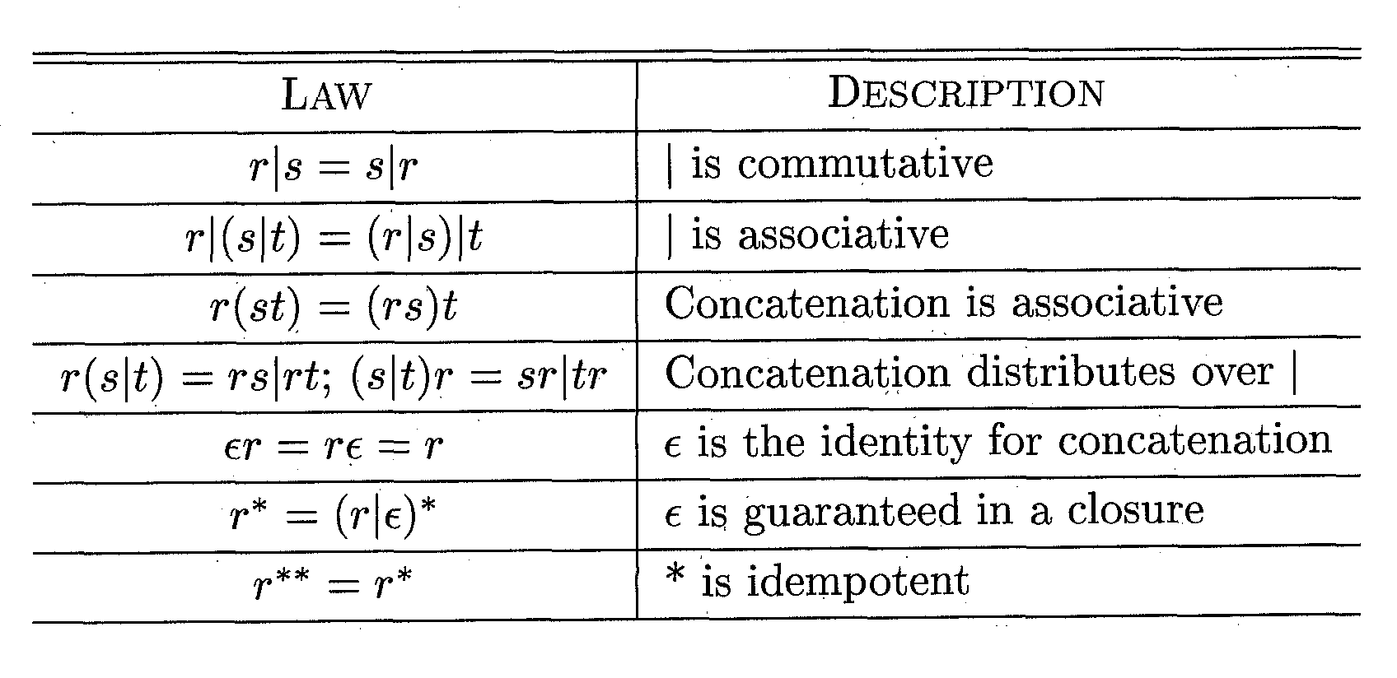
Algebraic laws for Regular Expressions

Slide 25
Regular Languages
R|S = either R or S
RS = R followed by S (concatenation)
R* = concatenation of R zero or more times
(R*= ε |R|RR|RRR...)
R? = ε | R (zero or one R)
R⁺ = RR* (one or more R)
(R) = R (grouping)
[abc] = a|b|c (any of listed)
[a-z] = a|b|....|z (range)
[^ab] = c|d|... (anything but ‘a’‘b’)

Slide 26
Regular Languages
RE Strings in L(R)
a “a”
ab “ab”
a|b “a” “b”
(ab)* “ ” “ab” “abab” ...
(a|ε)b “ab” “b”
Example: (Integers)
integer: a non-empty string of digits
digit = ‘0’|’1’|’2’|’3’|’4’|’5’|’6’|’7’|’8’|’9’
integer = digit digit*

Slide 27
Regular Languages
Example: (Identifiers)
identifier:
string or letters or digits starting with a letter
C identifier: [a-zA-Z_][a-zA-Z0-9_]*
Language L(R):
set of strings represented by a regular expression R. L(R) is the language denoted by regular expression R.

Slide 28
Regular Expressions
How can we use concepts developed so far to assist in recognizing tokens of a source language ?
Assume Following Tokens:
if, then, else, relop, id, num
What language construct are they used for ?
Given Tokens, What are Patterns ?
if → if
then → then
else → else
relop → < | <= | > | >= | = | <>
id → letter ( letter | digit )*
num → digit ⁺ (. digit ⁺ ) ? ( E(+ | -) ? digit ⁺ ) ?
What does this represent ? What is Σ ?

Slide 29
What Else Does Lexical Analyzer Do?
Throw Away Tokens
Fact
  Some languages define tokens as useless
  Example: C
    whitespace, tabulations, carriage return, and comments can be discarded without affecting the program’s meaning.
blank → b
tab → ^T
newline → ^M
delim → blank | tab | newline
ws → delim ⁺

Slide 30
Pseudo Codes
Removal of White Spaces [1]
for ( ; ; peek = next input character) {
if ( peek is a blank or a tab) do nothing;
else if ( peek is a new line ) line = line + 1;
else break;
}

Slide 31
Pseudo Codes
Constants [2]
If ( peek holds a digit ) {
v = 0;
do {
v = v * 10 + integer value of digit peek;
peek = next input character;
} while ( peek holds a digit );
return token (num , v)
}

Slide 32
Pseudo Codes
Recognizing Keywords and Identifiers [3]
Hashtable words = new Hashtable(); //in Java class
If ( peek holds a letter ) {
collect letters or digits into a buffer b;
s = string formed from the characters in b;
w = token returned by words.get(s);
if ( w is not null ) return w;
else {
Enter the key-value pair (s, <id, s>) into words
return token<id, s>;
}
}

Slide 33
Pseudo Codes
Lexical Analyzer
Token scan() {
skip white space, as in [1]
handle numbers, as in [2]
handle reserved words and identifiers [3]
Token t = new Token(peek);
Peek = blank
return t;
}

Slide 34
UNIT 4.4
Home
  Recognition of Tokens

Slide 35
Recognition of Tokens
digit → [0-9]
digits → digit+
number → digits (. digits)? (E [+-]? digits )?
letter → [A-Za-z]
id → letter (letter | digit)*
if → if
then → then
else → else
relop → < | > | <= | >= | = | <>
ws → (blank | tab | newline)+

Slide 36
Recognition of Tokens
LEXEMES | TOKEN NAME | ATTRIBUTE VALUE
Any ws | -
If | If
Then | Then
Else | Else
Any id | Number
< | Relop | LT
<= | Relop | LE
> | Relop | GT
>= | Relop | GE
= | Relop | EQ
<> | Relop | NE

Slide 37
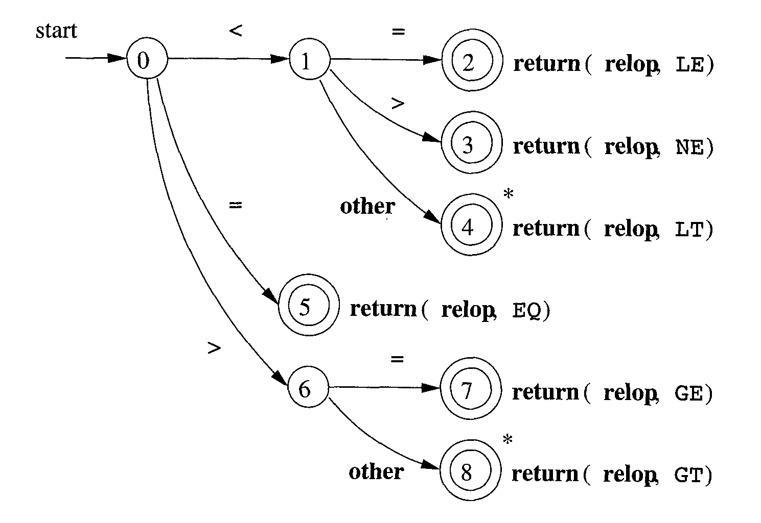
Transition Diagram

Slide 38
Architecture of a Transition-Diagram-Based Lexical Analyzer
TOKEN getRelop() //C++ code
{
TOKEN retToken = new(RELOP);
while(1) { /* repeat character processing until a return or failure occurs */
switch(state) {
case 0: c = nextChar();
if(c == ‘<‘) state = 1;
else if (c == ‘=‘) state = 5;
else if (c == ‘>’) state = 6;
else fail();
break; //lexeme is not a relop
}
case 1: …
…
case 8: retract();
retToken.attribute = GT
return(retToken);
}
}

Slide 39
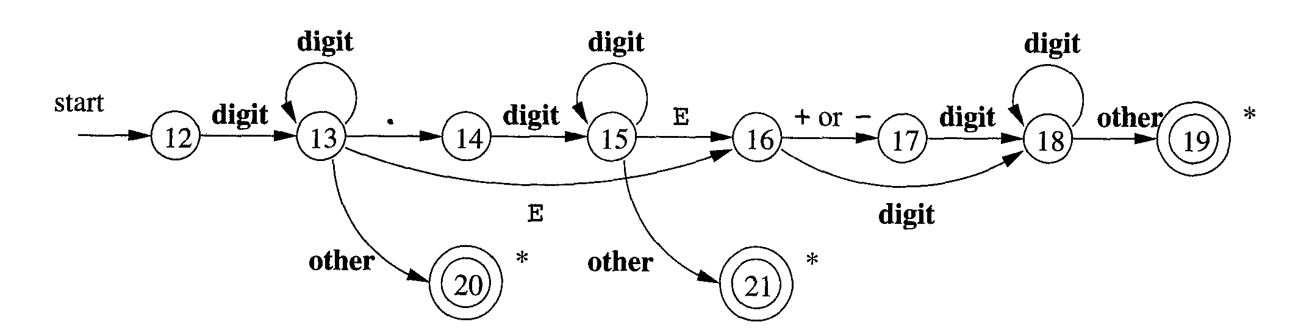
Task
Draw a TD for a given RE:
number → digits (. digits)? (E [+-]? digits )?

Slide 40
Tasks
Task01: Construct a Regular Definition for unsigned numbers (integer for floating point) are strings such as 528, 0.015, 6.33E4, 1.89E-4, etc.
digit → 0 | 1 | . . . | 9
digits → digit digit*
optionalFraction → . digits | empty
optionalExponent → (E ( + | - | empty ) digits ) | empty
number → digits optionalFraction optionalExponent
digit → [0-9]
digits → digit+
number → digits (. digits)? (E [+-]? digits )?

Slide 41
Tasks
Task02: Describe the languages denoted by the following regular expressions:
((empty | a) b*)*
2) (aa|bb)* ((ab|ba)(aa|bb)*(ab|ba)(aa|bb)*)*
Task03: Construct a RE for a keyword in a case-insentitive language. Illustrate the idea by writing the expression for “SELECT” keyword.

Slide 42
Exercises

Slide 43
Exercises

Slide 44
Thank you

Slide 45
Content Taken From
Compilers Principles, Techniques and Tools by Alfred V. Aho, Ravi Sethi and Jeffry D. Ulman
Web URL:
https://www.thecrazyprogrammer.com/2017/02/lexical-analyzer-in-c.html
https://slideplayer.com/slide/8459297/
https://www.coursehero.com/file/50240138/Lec-6pptx/

